Slide 1
Education Capital Information System (ECIS)
Ministry of Education
SLDV ECIS instructions for School Board Users

Slide 2
Current Year Instructions

Slide 3
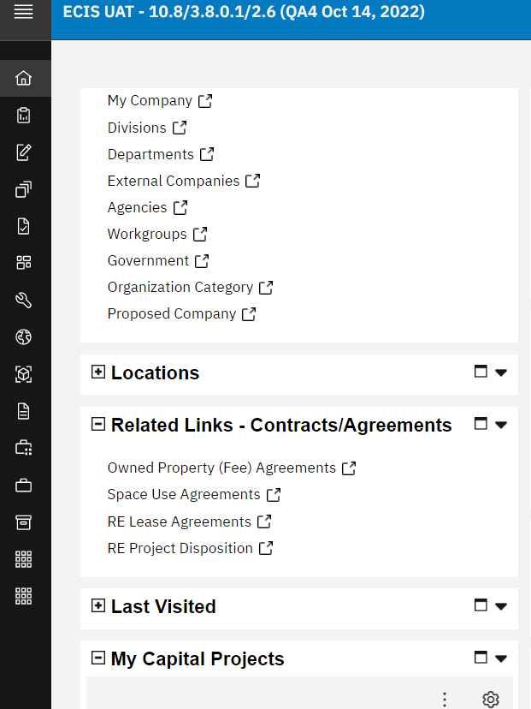
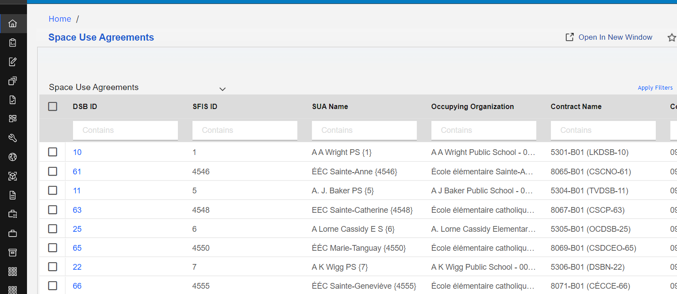
EDIT SUA Name
1.
4.
3.
5.
2.
1. Select 'Home'
2. Select 'Space Use Agreement'
3. Enter 'SFIS ID'
4. Select 'Apply Filter' (or press ENTER)
5. Select to open the record (one click is enough)
6. Select 'Revise'
7. Edit to NEW SUA Name
6.
7.
3

Slide 4
EDIT SUA Name
8. Double check that the Program/Division record is the name that is expected/desired, if not, please select the Organization Path highlighted as part of this step, 8, and proceed further.
9. Division/Program form will open, prior to step. Navigate to the Division form, select 'Revise' link
10. Select 'Systems' menu option
11. Navigate to 'Associated Space Level Occupancy Allocation' section
12. Select 'Refresh Org Name' link
13. Select 'Activate' and record's status will remain in 'Review in Progress' until it is approved by EDU.
10.
9.
13.
11.
12.
8.
13.
4

Slide 5
EDIT SUA Name
Return to previously open SUA form, proceed to step 14, if no other edits on the SUA form are needed (such as Expiration Date, Panel; Commencement Date; Lowest/Highest Grade or if Program/Division has moved:
14. Select 'Save on the previously open SUA form
15. Select 'Issue'. SUA form will close and will be sent for approval. Following the approval, the status will change from ‘Review in Progress’ to ‘Active’. The submitting user will receive a notification of the approval.
15.
14.
5

Slide 6
EDIT SUA Expiration Date
1.
4.
3.
5.
2.
1. Select 'Home'
2. Select 'Space Use Agreement'
3. Enter 'SFIS ID'
4. Select 'Apply Filter' (or press ENTER)
5. Select to open the record (one click is enough)
6. Select 'Revise'
7. navigate to the 'SUA Dates' section
8. Enter Date
9. Select 'Issue' if no other edits are needed on the SUA form
Issue
9.
6.
7.
8.
6

Slide 7
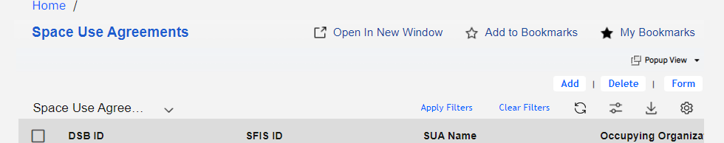
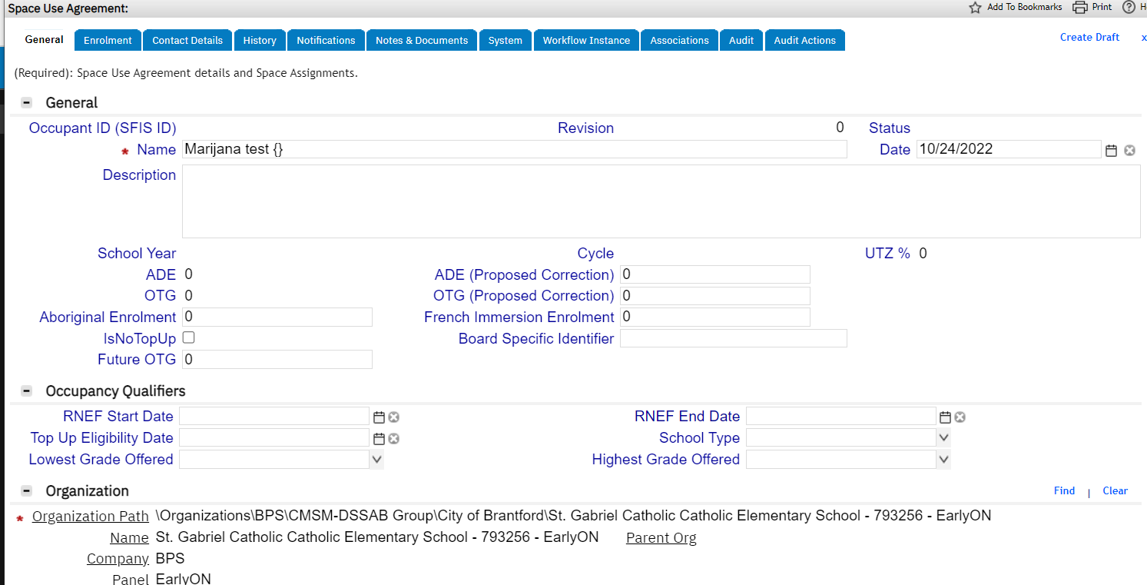
EDIT SUA Commencement Date
1.
3.
4. On General tab > Populate the Mandatory (*) fields:
Name = Short name of the school/program (i.e. Odre Street PS { }). The curly brackets need to have the SFIS ID filled out inside; the SFIS ID will be available after Create Draft is pressed. After this number is created it is to be added inside.
Organization Path – select Find, look for the Division record corresponding to this SUA name.
Commencement Date – start date of the program.
5. Click Create Draft button
6. Select Save
7. Select Issue – record will go for approval and the status will remain as Review in progress until the record is approved.
Issue
Save
7.
6.
5.
4.
2.
4.
4.
7

Slide 8
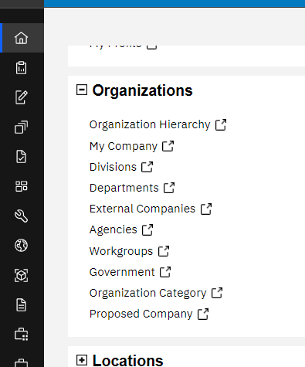
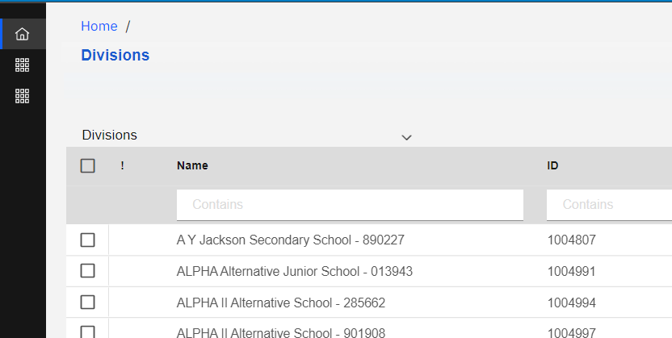
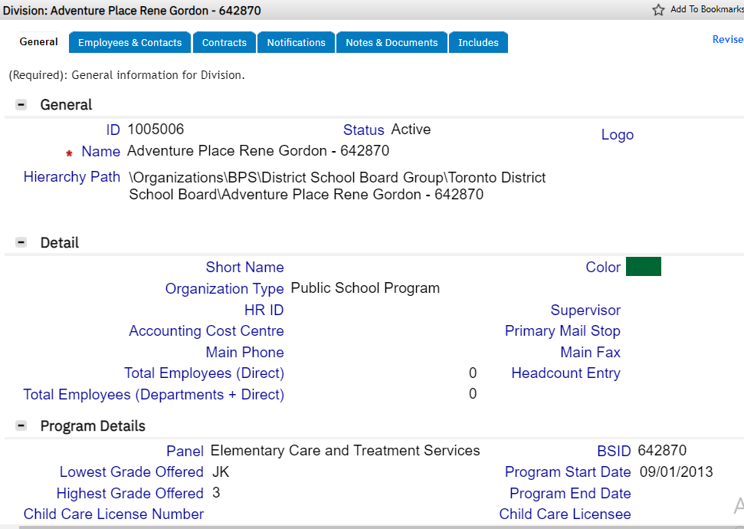
Division Program moved
1.
1. Select 'Home'
2. Select 'Division'
3. This step is to ensure the correct division number that is intended to be moved is reviewed before re-attaching to new (moved to) SUA. Enter BSID & press Enter
4. Select to open resulting record
5. Review Program info
2.
3.
4.
5.
8

Slide 9
Division Program moved
6.
8.
7.
9.
6. Select 'Space Use Agreement'
7. Enter 'SFIS ID'
8. Select 'Apply Filter' (or press ENTER)
9. Select to open the record (one click is enough)
9

Slide 10
Division Program moved
15.
Issue
Save
Revise
17.
16.
10.
13.
18.
13.
14.
10. Select 'Revise'
11. Select 'Find'
12. Place cursor and press enter to upload data
13. Enter BSID and press enter or apply Filter
14. Select the desired Program/Division
15. Press 'OK'
16.Select 'Save'
17. Select 'Issue'
18. Record’s Status will remain ‘Review in Progress’ until approvers approves the record, after which point it will turn the status to Active.
11.
12.
10

Slide 11
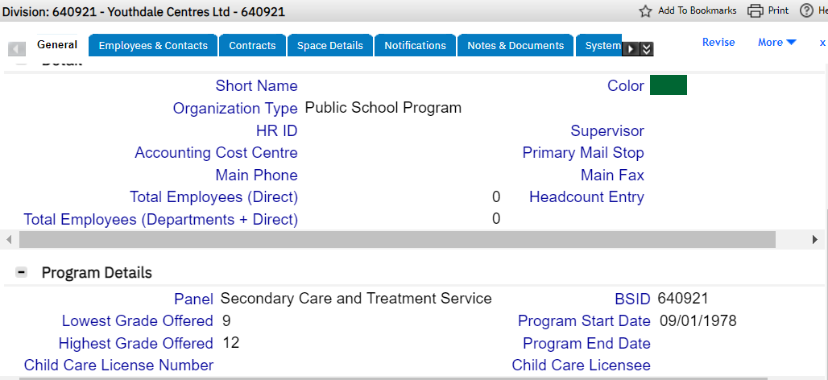
EDIT Division Program End Date
1.
1. Select 'Home'
2. Select 'Division'
3. Enter BSID & press Enter
4. Select to open resulting record
5. Select 'Revise'
6. Enter 'Program End Date'
7. Select 'Activate' and record's status will remain in 'Review in Progress' until it is approved by EDU.
2.
3.
4.
7.
5.
6.
11

Slide 12
EDIT SUA: Panel; Commencement Date; Lowest/Highest Grade;
1.
4.
3.
5.
2.
1. Select 'Home'
2. Select 'Space Use Agreement'
3. Enter 'SFIS ID'
4. Select 'Apply Filter' (or press ENTER)
5. Select to open the record (one click is enough)
12

Slide 13
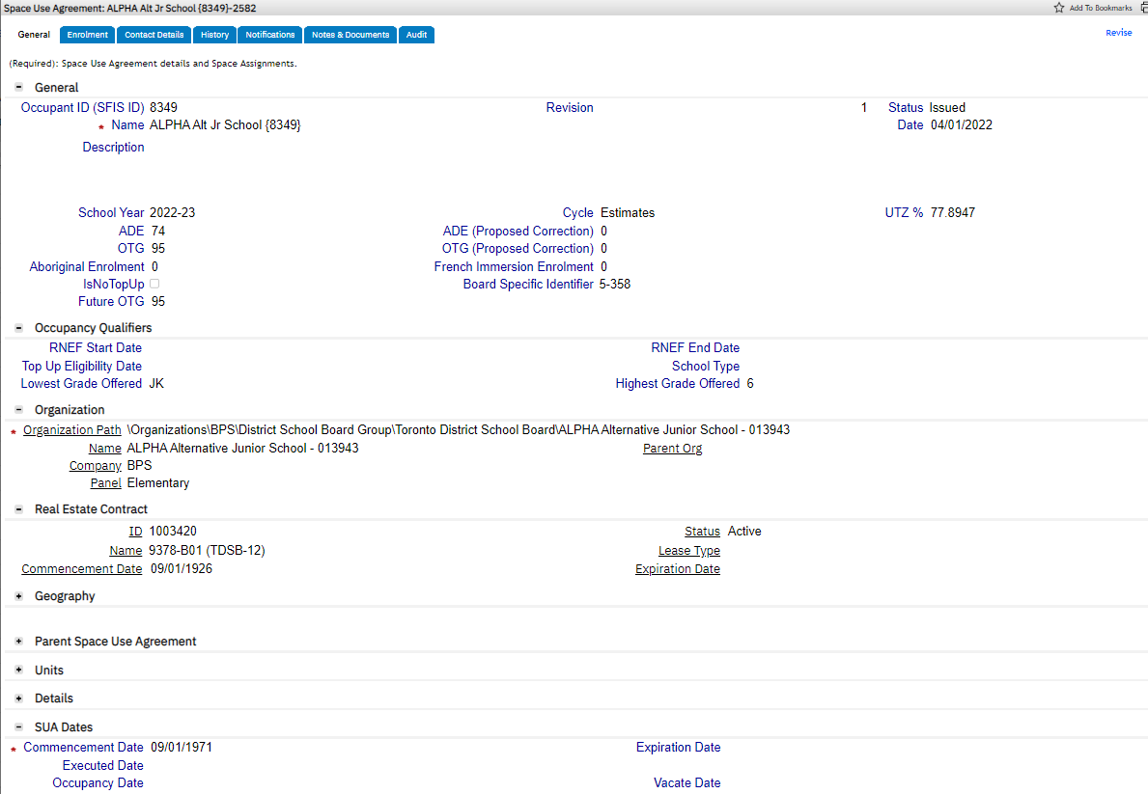
EDIT SUA: Panel; Commencement Date; Lowest/Highest Grade;
Issue
11.
6.
6. Select 'Revise'
7. Confirm 'Panel’ (associated from Division record)
8. Edit or Enter New 'Commencement Date'
9. Enter 'Lowest grade'
10. Enter 'Highest grade'
11. Select ‘Issue' and record's status will remain in 'Review in Progress' until it is approved by EDU.
9.
10.
7.
8.
13

Slide 14
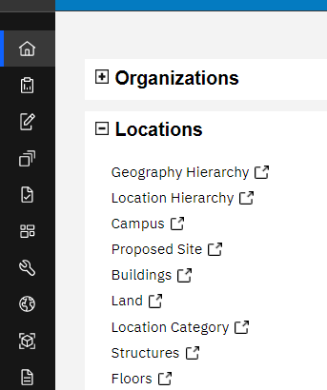
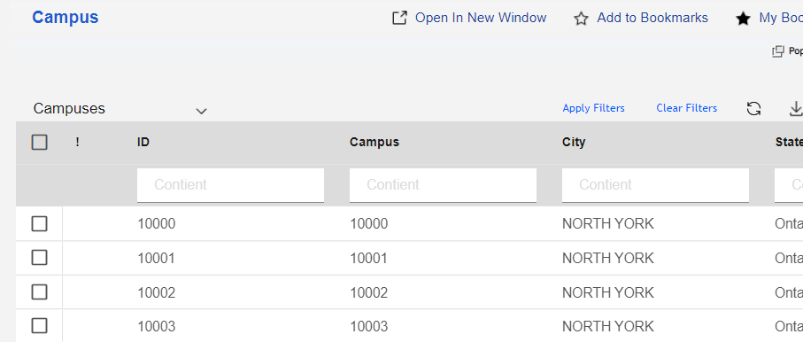
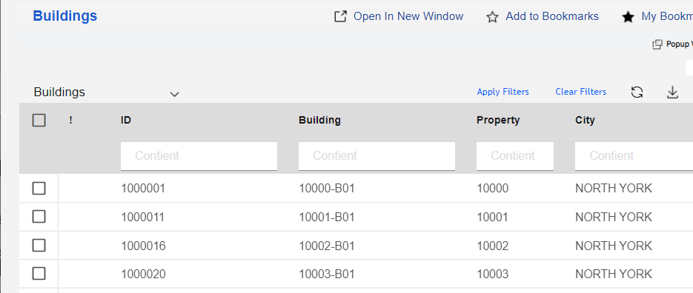
EDIT Building: Operational Status; Tenure
Two ways to navigate to a Building record:
1 a. Select 'Building'
1 a. Select or Search for a desired 'Building' from the Building Data query table.
1 b. Select 'Campus'
1 b. Select (or search for) desired Campus record
1 b. Open Campus record and navigate to 'includes' tab.
1 b. Select desired Building
1 b. Select 'Open'
1b.
1b.
1a.
1b.
1a.
1b.
1b.
14

Slide 15
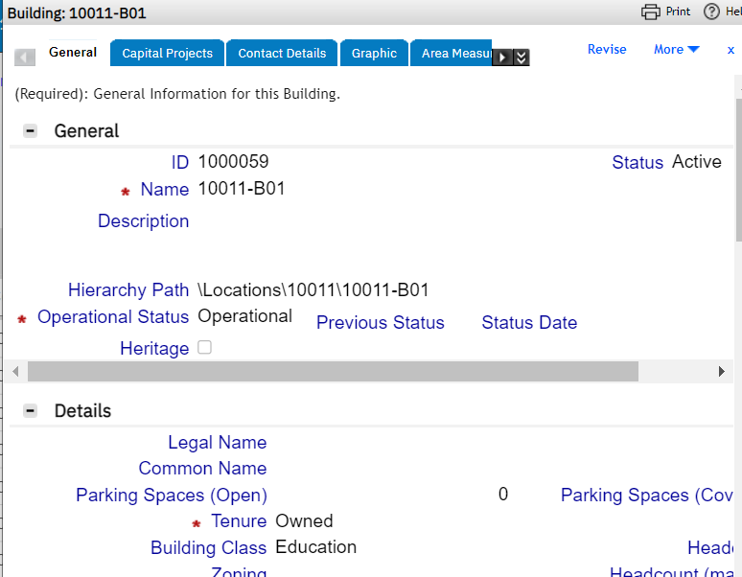
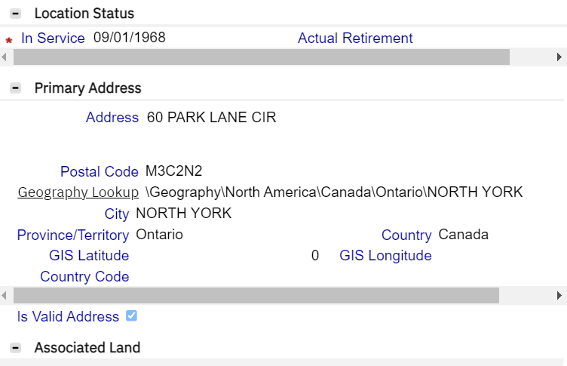
EDIT Building: Operational Status; Tenure
2. Building Record opens
3. Select 'Revise'
3.
4 Building Operational Status | Status Definition
Proposed | Record Status in Draft; A Proposed Building is a Building a board wishes to submit for a Funding Request to meet the needs of the board. This Building doesn’t exist as a collection of assets in the boards Inventory. It is the first step in the creation of a building asset.
Associated | Record Status in Draft; An Associated Building is a Building a board has associated to a Funding Request. If a funding Request is approved, it becomes an active record with the Operational Status of Planned; if the Funding Request is denied the school board user reverts the Operational Status of Proposed for future funding request submissions. A building should not remain in an associated operational status after the Funding Submission Cycle has come to and end and all projects have either been approved or denied.
Planned | Record Status is Active; A Planned Building is a Building that has been Approved by a Funding Request and is a part of a Capital Project.
Under Construction | Record Status is Active; A Under Construction Building is a Building that has been Approved by a funding Request and is a part of a Capital Project that has Approval through the ATP process to begin construction. It remains in this status until all spaces have been created and an Issued SUA between an Active Division and the Space(s) in the building.
Operational | Record Status is Active; An Operational Building is a Building with an Operational Asset when it is in use by any user. This means it has an active location asset on it, or divisions to associated SUAs and its Space(s). Or it has the classification and primary use of Recreation.
Inactive | Record Status becomes Retired; A Building is Inactive when it is no longer an asset of the board. Whether the asset has been, sold, or the lease ended, the operational status is Inactive, the record is then retired in the system.
Unverified | Operational status of an unverified Campus record. Follow up with the board to confirm the status of the record
4.
5.
6.
5. Mandatory Field - two options : Owned or Leased. Owned = When a building asset is owned by a board. An Owned Fee Agreement for the Campus must be created, and the tenure is Owned. Leased = When a building asset is leased by a board. A RE Lease Agreement must be created for the building and the tenure is Leased. (Records set to Managed are for assets where the Tenure Status of Owned or Leased is unclear) Sidebar notes: If a board leases a building or space from another board a RE Lease agreement is created for use of space in that building. If a board leases space from a 3rd Party building. The board must create an OFA for the 3rd Party and then create a RE Lease agreement to indicate the Leased use of the building and its space.
15
6. Integration populated field - pulled from VFA asset file OPENDATE, signifying the date that the building opened (active start date). The format of this field is MM/DD/YYYY.

Slide 16
EDIT Building: Address
Two ways to navigate to a Building record:
1 a. Select 'Building'
1 a. Select or Search for a desired 'Building' from the Building Data query table.
1 b. Select 'Campus'
1 b. Select (or search for) desired Campus record
1 b. Open Campus record and navigate to 'includes' tab.
1 b. Select desired Building
1 b. Select 'Open'
1b.
1b.
1a.
1b.
1a.
1b.
1b.
16

Slide 17
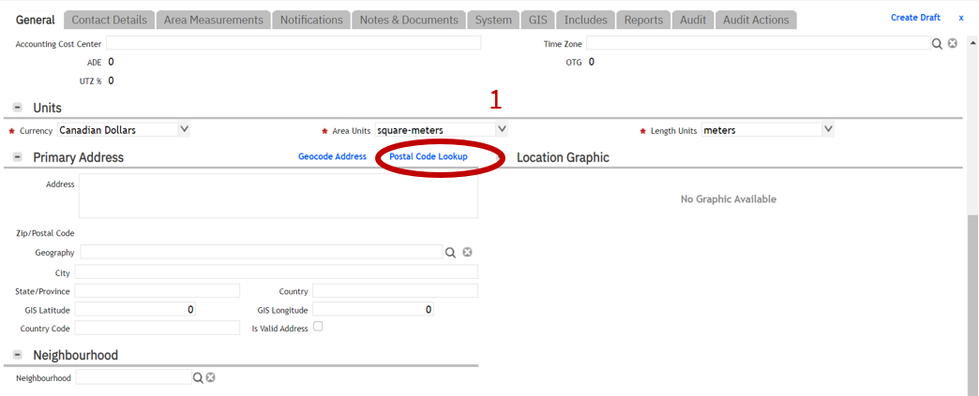
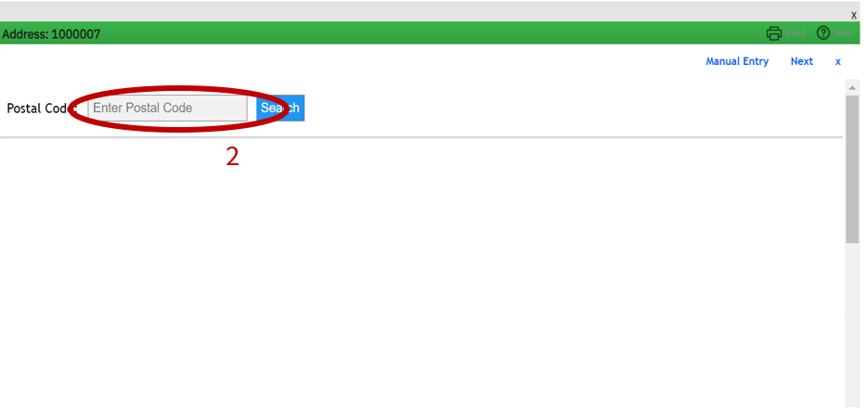
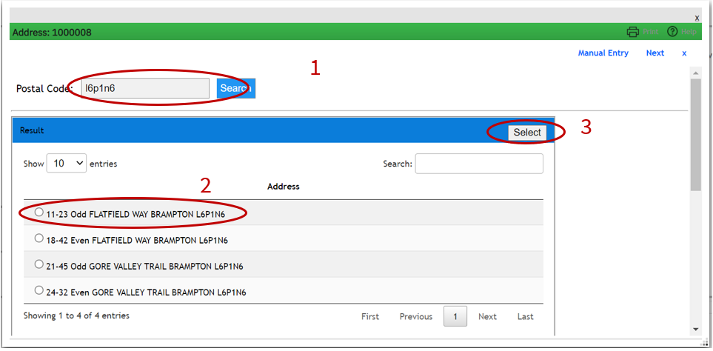
EDIT Building: Address
2.
2.
3.
2. Select ‘Create Draft’ and Click on Postal Code Lookup
3. Enter Postal code
4. Press Search
5. Select the desired address
6a. Press SELECT
4.
6a.
5.
17

Slide 18
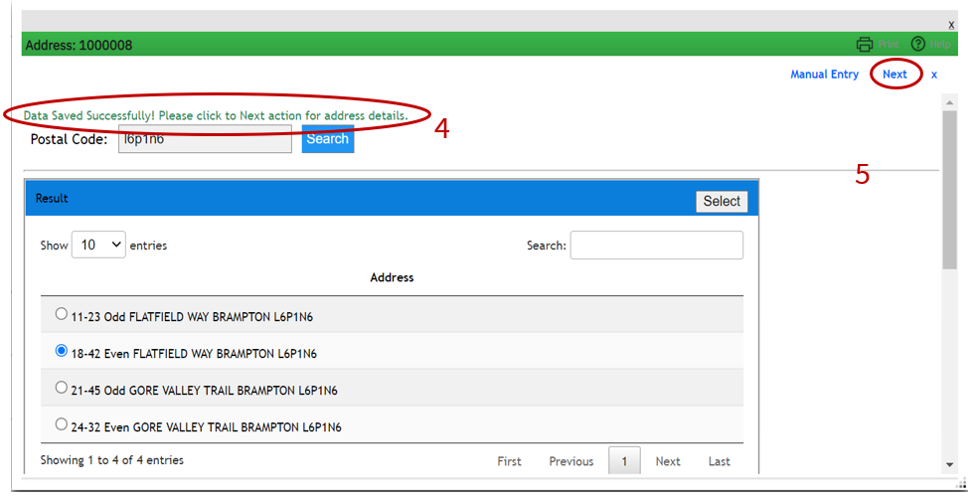
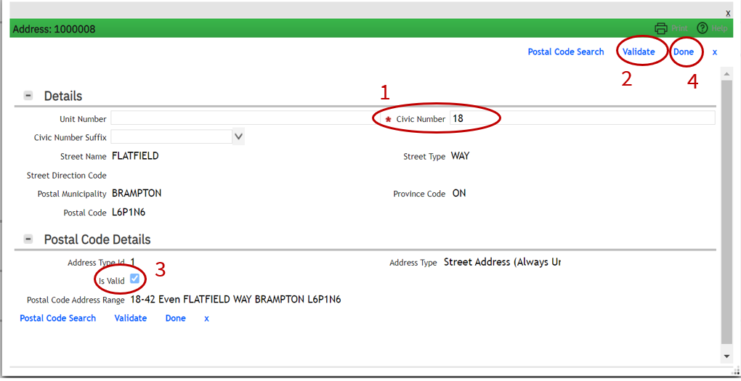
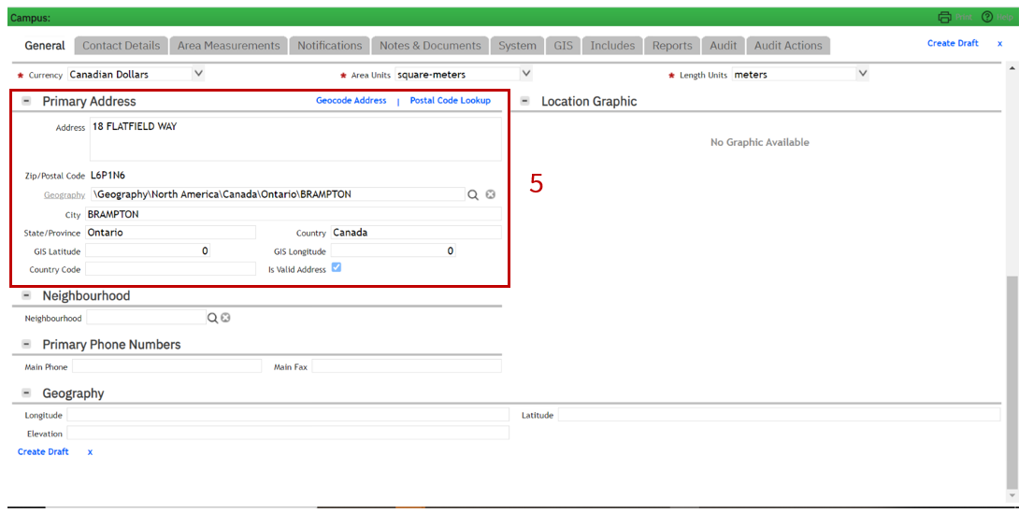
EDIT Building: Address
6b. Message will appear in green “Data Saved…”
7. Press ‘NEXT’
8. Under ‘Details’ section, Civic Number will populate
9. Select ‘Validate’
10. Is Valid checkbox should be checked
11. Select ‘Done’
12. Primary Address section is going to be populated
13. Select ‘Activate’. Record will remain in ‘Review in Progress’ until approval is granted. Record will close.
6b.
7.
13.
Activate
8.
9.
11.
12.
10.
18

Slide 19
Future Year Instructions
19

Slide 20
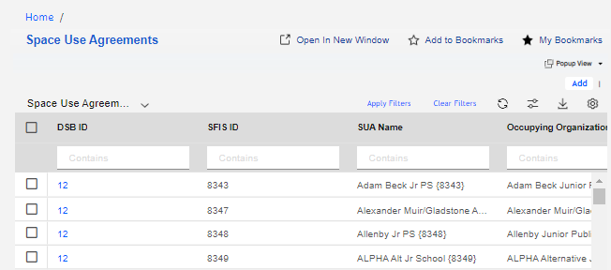
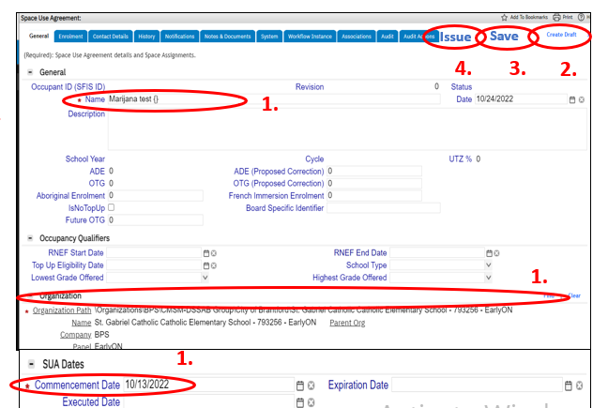
Option 1 - EDIT SUA Name – create a new SUA and save as a Draft ONLY
Option 1 is used when: the Comms date has not happened, and SUA not ISSUED, planned = DRAFT
1.
Select ‘Home’
Select ‘Space Use Agreement’
Space Use Agreement data query table will open. Select ‘Add’ on top-right corner.
On General tab > Populate the Mandatory (*) fields:
Name = Short name of the school/program (i.e. Odre Street PS { }). The curly brackets need to have the SFIS ID filled out inside; the SFIS ID will be available after Create Draft is pressed. After this number is created it is to be added inside.
Organization Path – select Find, look for the Division record (BSID) corresponding to this SUA name. If no BSID exists, link to ‘My Company’ (DSB) for creation of Draft SUA.
Commencement Date – start date of the program. This will be a future date.
Click Create Draft button ONLY – as for the future SUA, we would not want to go any further and issue.
3.
ISSUE
Create Draft
2.
5.
6.
Only for
Current Year
4.
***Steps 6 (to ISSUE) is only added for NEW SUA’s that are for the Current year)
4.
4.
20

Slide 21
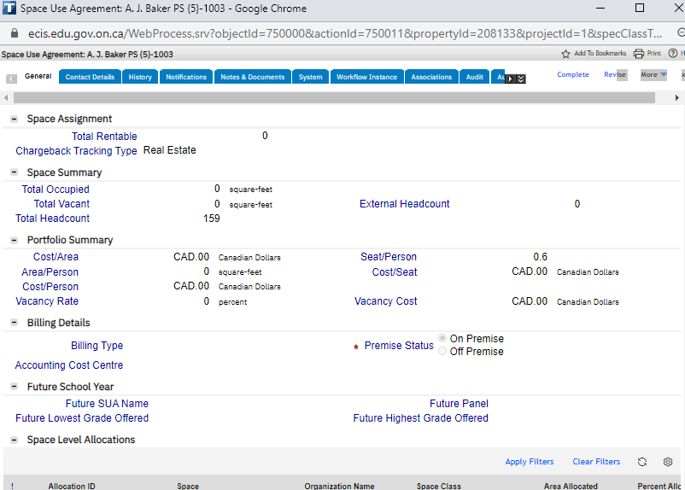
Option 2 - EDIT Future SUA Name – if existing SUA has a Future Name with same attributes
1.
Option 2 is used when: the Comms date has happened, and SUA is ISSUED
Select ‘Home’
Select ‘Space Use Agreement’
Space Use Agreement data query table will open. Select or Search for the desired SFIS ID
Select ‘Revise’
Enter ‘Future Name’ = Short name of the school/program (i.e. Odre Street PS { }). The curly brackets need to have the SFIS ID filled out inside; the SFIS ID will be available after Create Draft is pressed. After this number is created it is to be added inside
Select ‘Issue’ and the record will close. The status of the record will remain in ‘Review in Progress’ until the EDU staff approves this request. Following which the status will change to ‘Active’.
3.
2.
Issue
Revise
6.
4.
5.
21

Slide 22
EDIT SUA Expiration Date
1.
4.
3.
5.
2.
1. Select 'Home'
2. Select 'Space Use Agreement'
3. Enter 'SFIS ID'
4. Select 'Apply Filter' (or press ENTER)
5. Select to open the record (one click is enough)
6. Select 'Revise'
7. navigate to the 'SUA Dates' section
8. Enter Date
Select 'Issue' if no other edits are needed on the SUA form
6.
7.
8.
22

Slide 23
Division Program moved
1.
2.
3.
4.
5.
1. Select 'Home'
2. Select 'Division'
3. This step is to ensure the correct division number that is intended to be moved is reviewed before re-attaching to new (moved to) SUA. Enter BSID & press Enter
4. Select to open resulting record
5. Review Program info
23

Slide 24
Division Program moved
6.
8.
7.
9.
6. Select 'Space Use Agreement'
7. Enter 'SFIS ID'
8. Select 'Apply Filter' (or press ENTER)
9. Select to open the record (one click is enough)
24

Slide 25
Division Program moved
15.
Issue
Save
Revise
17.
16.
10.
13.
18.
13.
14.
10. Select 'Revise'
11. Select 'Find'
12. Place cursor and press enter to upload data
13. Enter BSID and press enter or apply Filter
14. Select the desired Program/Division
15. Pres 'OK'
16.Select 'Save'
17. Select 'Issue'
18. Record’s Status will remain ‘Review in Progress’ until approved approves which will turn the status to Active.
11.
12.
25

Slide 26
EDIT Division Program End Date
1.
1. Select 'Home'
2. Select 'Division'
3. Enter BSID & press Enter
4. Select to open resulting record
5. Select 'Revise'
6. Enter 'Program End Date'
7. Select 'Activate' and record's status will remain in 'Review in Progress' until it is approved by EDU.
2.
3.
4.
7.
5.
6.
26

Slide 27
EDIT SUA: Panel; Commencement Date; Lowest/Highest Grade;
1.
4.
3.
5.
2.
1. Select 'Home'
2. Select 'Space Use Agreement'
3. Enter 'SFIS ID'
4. Select 'Apply Filter' (or press ENTER)
5. Select to open the record (one click is enough)
27

Slide 28
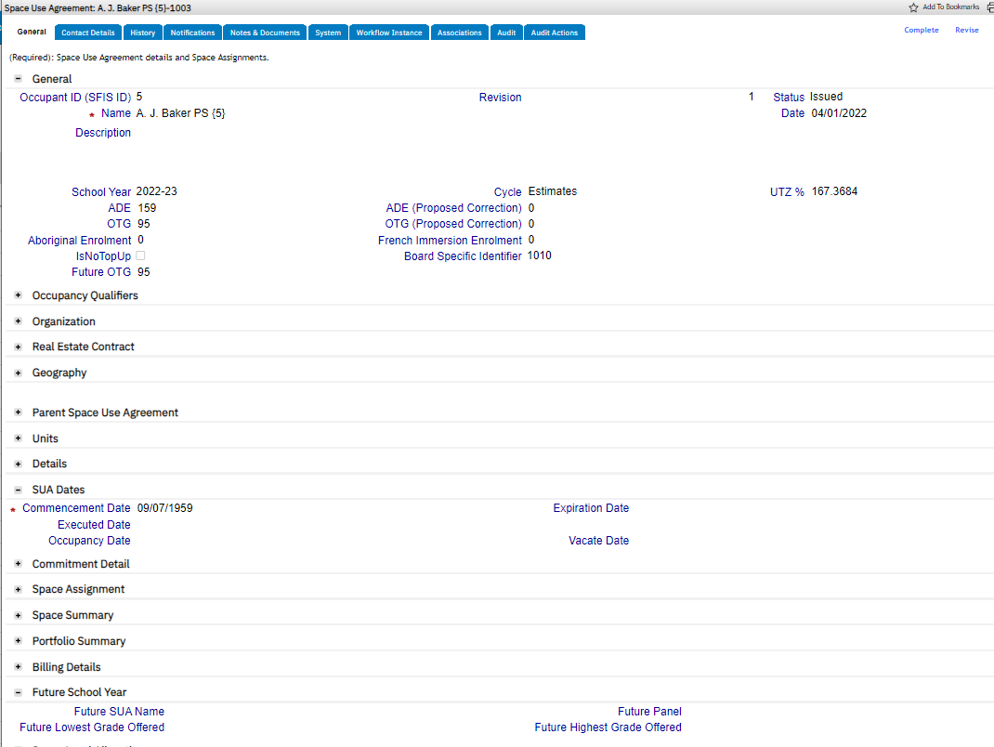
EDIT SUA: Future: Lowest/Highest Grade; Panel; OTG - and (Commencement Date – can be future by design)
Issue
12.
6.
6. Select 'Revise'
7. Enter 'Future Lowest grade'
8. Enter 'Future Highest grade'
9. Choose desired 'Future Panel'
10. Edit or Enter New 'Commencement Date'
12. Enter 'Future OTG'
11. Select ‘Issue' and record's status will remain in 'Review in Progress' until it is approved by EDU.
11.
10.
9.
7.
8.
28

Slide 29
EDIT Building: Operational Status; Tenure
Two ways to navigate to a Building record:
1 a. Select 'Building'
1 a. Select or Search for a desired 'Building' from the Building Data query table.
1 b. Select 'Campus'
1 b. Select (or search for) desired Campus record
1 b. Open Campus record and navigate to 'includes' tab.
1 b. Select desired Building
1 b. Select 'Open'
1b.
1b.
1a.
1b.
1a.
1b.
1b.
29

Slide 30
EDIT Building: Operational Status – explanation for Future Scenarios
2. Building Record opens
Operational Status – select one of the following dropdown options::
when the building is Operational the user has to provide the room details to be able to link SUA’s.
When no more SUA in the building the building becomes Vacant (no longer holding)
When a building is under construction, the status is Under-construction and there are no SUA’s active.
When a building is being Demolished there are no SUA’s active, the status has changed to Inactive and the building record is Retired.
When a building is SOLD this also starts the disposition project. SB must provide transfer of title to EICCU: ECIS.Admin@ontario.ca, the status of the building is switched to Inactive (as well as Campus and Land if all are sold) and the building record is Retired.
30

Slide 31
EDIT Building: Operational Status; Tenure
3. Select 'Revise'
3.
4 Building Operational Status | Status Definition
Proposed | Record Status in Draft; A Proposed Building is a Building a board wishes to submit for a Funding Request to meet the needs of the board. This Building doesn’t exist as a collection of assets in the boards Inventory. It is the first step in the creation of a building asset.
Associated | Record Status in Draft; An Associated Building is a Building a board has associated to a Funding Request. If a funding Request is approved, it becomes an active record with the Operational Status of Planned; if the Funding Request is denied the school board user reverts the Operational Status of Proposed for future funding request submissions. A building should not remain in an associated operational status after the Funding Submission Cycle has come to and end and all projects have either been approved or denied.
Planned | Record Status is Active; A Planned Building is a Building that has been Approved by a Funding Request and is a part of a Capital Project.
Under Construction | Record Status is Active; A Under Construction Building is a Building that has been Approved by a funding Request and is a part of a Capital Project that has Approval through the ATP process to begin construction. It remains in this status until all spaces have been created and an Issued SUA between an Active Division and the Space(s) in the building.
Operational | Record Status is Active; An Operational Building is a Building with an Operational Asset when it is in use by any user. This means it has an active location asset on it, or divisions to associated SUAs and its Space(s). Or it has the classification and primary use of Recreation.
Inactive | Record Status becomes Retired; A Building is Inactive when it is no longer an asset of the board. Whether the asset has been, sold, or the lease ended, the operational status is Inactive, the record is then retired in the system.
Unverified | Operational status of an unverified Campus record. Follow up with the board to confirm the status of the record
4.
5.
6.
5. Mandatory Field - two options : Owned or Leased. Owned = When a building asset is owned by a board. An Owned Fee Agreement for the Campus must be created, and the tenure is Owned. Leased = When a building asset is leased by a board. A RE Lease Agreement must be created for the building and the tenure is Leased. (Records set to Managed are for assets where the Tenure Status of Owned or Leased is unclear) Sidebar notes: If a board leases a building or space from another board a RE Lease agreement is created for use of space in that building. If a board leases space from a 3rd Party building. The board must create an OFA for the 3rd Party and then create a RE Lease agreement to indicate the Leased use of the building and its space.
31
6. Integration populated field - pulled from VFA asset file OPENDATE, signifying the date that the building opened (active start date). The format of this field is MM/DD/YYYY.

Slide 32
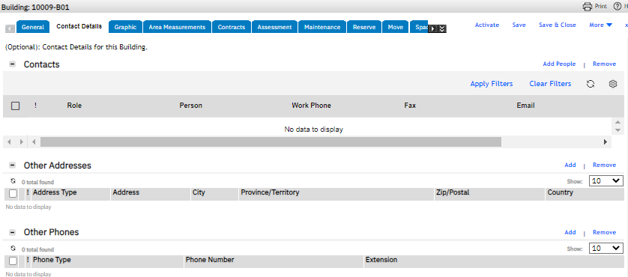
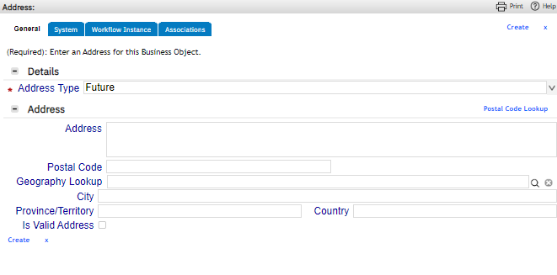
EDIT Building: for Future Address
1. Select 'Building' on Location widget
2. Building query data table will open - search for desired building and select one time to open.
3. On the Building record, select 'Revise'
4. Navigate to 'Contact Details' menu tab
5. Under 'Other Addresses' section, select 'Add'
6. New pop up window will open, under field Address Type, dropdown menu option of 'Future' should be chosen.
7. Click on Postal Code Lookup
2.
1.
3.
Revise
4.
6.
7.
5.
32

Slide 33
EDIT Building: Address
8.
8. Enter Postal code
9. Press Search
10. Select the desired address
11. Press SELECT
9.
11.
10.
33

Slide 34
EDIT Building: Address
12. Message will appear in green “Data Saved…”
13. Press ‘NEXT’
14. Under ‘Details’ section, Civic Number will populate
15. Select ‘Validate’
16. Is Valid checkbox should be checked
17. Select ‘Done’, pop-up will close
18. ‘Other Address’ section is going to be populated
19. Select ‘Activate’. Record will remain in ‘Review in Progress’ until approval is granted. Record will close.
12.
13.
19.
14.
15.
17.
18.
16.
Future
34

