Slide 1
The Road Map to Reporting Workplace Violence in Ontario School Boards: A Training Resource for Principals and Staff This PowerPoint supports the use of the Road Map Training Resource in professional development. 2019
Including Presenter Notes
Notes:
Presenter Notes:
The Road Map to Reporting Workplace Violence in Ontario School Boards: A Training Resource for Principals and Staff (referred to as the Training Resource) supports the use of the “Road Map” in Appendix H of the Ministry of Labour’s document Workplace Violence in School Boards.
The PowerPoint provides a step-by-step introduction to the Training Resource.
Participants will benefit from having their own copies of the Training Resource on hand during the PowerPoint presentation.
A workshop using this PowerPoint to introduce the Training Resource can be completed in about one hour.

Slide 2
This PowerPoint supports the use of the Road Map Training Resource
The Road Map to Reporting Workplace Violence in Ontario School Boards: A Training Resource for Principals and Staff is an introduction to the “Road Map” in Appendix H of the Ministry of Labour’s document Workplace Violence in School Boards.
The Training Resource provides information, charts, and scenarios about the reporting requirements laid out on the Road Map.
This PowerPoint supports the use of the Training Resource in professional development. Please keep your copy of the Training Resource handy during the use of the PowerPoint.
Training Resource
and PowerPoint
The Road Map
Notes:
Presenter Notes:
Participants can be encouraged to follow the progress of the PowerPoint using their own copy of the Training Resource.

Slide 3
The Road Map Training Resource: What’s in it?
CONTENTS
Introduction
Roles, Responsibilities, and Rights
Getting Started with the Road Map
Following the Road Map
Reporting Workplace Violence Incidents (OHSA)
Reporting Serious Student Incidents (Education Act)
Reporting Workplace Injuries (WSIA)
Appendices, including charts, scenarios, and additional information
Resources
Notes:
Presenter Notes:
(Contents)
The Training Resource introduces principals and school staff to the Road Map.
The Training Resource highlights reporting requirements laid out in statutes and policies.
It sets out reporting duties.
The appendices include a chart, definitions, scenarios, and additional information for discussion and future use.
Please encourage participants to refer to the Training Resource for further information.

Slide 4
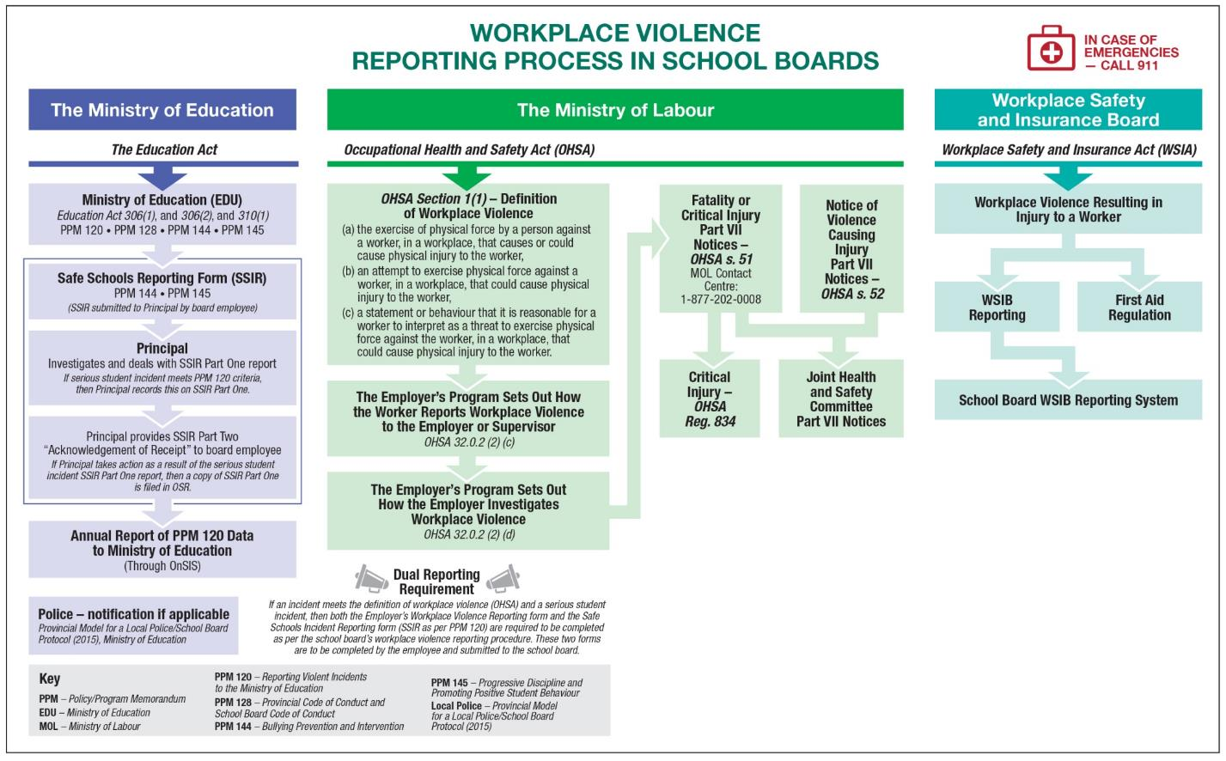
The Road Map: A practical tool
Notes:
Presenter Notes:
Here is the flow chart version of the Road Map.
Consider it a “bird’s-eye view” of the reporting processes that may be required in response to a violent incident.
There are three main areas on the Road Map:
The green section in the middle shows the required reporting process for workplace violence under the Occupational Health and Safety Act.
The blue section on the left shows the required reporting process for serious student incidents under the Education Act and Ministry of Education policy.
The aqua section on the right shows the required reporting process for work-related injuries under the Workplace Safety and Insurance Act and Workplace Safety and Insurance Board policy.

Slide 5
INTRODUCTION
What is the Road Map?
A practical tool for principals and staff developed in response to the need for greater clarity about workplace violence reporting processes in our schools.
A tool that focuses on three main reporting processes for violent incidents.
Developed by the Provincial Working Group on Health and Safety.
The Training Resource and this PowerPoint provide you with background information about the Road Map.
Notes:
Presenter Notes:
(Introduction)
The Road Map is a practical tool for principals and staff to guide decision making when following the reporting processes for violent incidents.
These reporting processes are required by statute (laws) or policies.
The Road Map focuses on reporting processes for violent incidents under the Occupational Health and Safety Act (OHSA), the Education Act, and the Workplace Safety and Insurance Act (WSIA).
The Training Resource provides background information and additional resources to support principals and staff in their use of the Road Map.
The PowerPoint supports the use of the Training Resource.
The Provincial Working Group on Health and Safety.
The Provincial Working Group on Health and Safety includes representatives from school boards, teacher federations, education worker unions, principal associations, and government.
The Working Group members have a common goal: to help ensure that schools are safe places to learn and work for all members of the school community.

Slide 6
ROLES, RESPONSIBILITIES, AND RIGHTS
Roles
The statutes (laws) and policies that are referred to in the Road Map use different terms to identify equivalent roles. The school board is also the employer. The principal is also a board employee and a supervisor. The board employee is also a worker.
Responsibilities
Everyone in the school board plays a part to ensure that schools are safe places to work and to learn.
Rights
Workers have the right to participate, the right to know, and the right to refuse unsafe work. Note that teachers have a limited right to refuse unsafe work when a pupil is in jeopardy (Regulation 857: Teachers).
Notes:
Presenter Notes:
(Roles, responsibilities, and rights)
In this section, the Training Resource takes a step back from the Road Map to review some essentials on the next three slides:
identifying workplace roles, even when different terms are used.
workplace responsibilities that include required duties.
the three basic rights for worker health and safety.

Slide 7
Principals and staff: supervisors and workers
Statutes use different terms to identify equivalent roles.
For example:
The principal is also a board employee and a worker.
If the principal is a victim of a violent incident, they need to report the incident.
The OHSA’s definition of “worker” includes students on unpaid work experience programs (i.e., high school co-op students, teacher candidates, early childhood educator candidates).
When these students are on placement in school boards,
they are workers too.
Education Act | OHSA | WSIA
School board | Employer | Employer
Principal | Supervisor | (Supervisor not referenced)
Board employees, other staff | Worker | Worker
Notes:
Presenter Notes:
(oles, responsibilities, and rights -- Roles and responsibilities)
The statutes (laws) and polices that are included on the Road Map use different terms to identify the school board, the principal, and board employees.
The use of these different but equivalent terms is carried into the Training Resource.
Each workplace party has an essential role in reporting processes for incidents of violence:
the school board as the employer;
the principal as the supervisor; and
school staff as board employees and workers.
In addition to their leadership role, the principal is also a board employee and a worker. If the principal is a victim of workplace violence, with or without injury, reporting requirements for board employees and workers also apply.
Under the OHSA, students on unpaid work experience programs are included in the definition of “worker”. These students have the rights and responsibilities of workers when they are on placement in a school board.

Slide 8
Examples of workplace responsibilities
Worker duty to report hazards (OHSA)
Workers have a duty to report the existence of any hazard that they know about to their employer or supervisor.
Reporting and investigating incidents of violence (OHSA)
The employer’s workplace violence program must include the means for workers to report workplace violence. It must also set out how the employer will investigate and deal with those reports.
Reporting and investigating serious student incidents (Education Act)
When a board employee becomes aware that a student may have engaged in a serious student incident, the employee must report this to the principal and the principal must investigate.
Employer’s duty to notify the WSIB (WSIA)
The employer must notify the WSIB within three days after learning of a worker’s injury that necessitates health care or results in the worker not being able to earn full wages.
Notes:
Presenter Notes:
(Roles, responsibilities, and rights -- Roles and responsibilities)
Each statute identified on the Road Map sets out the duties of workplace parties in the reporting process for violent incidents.
Following are more details about the examples provided, for your reference. Please also refer to the Training Resource for more information.
Worker duty to report hazards.
Workers have a duty to report any contravention of the OHSA or the existence of workplace hazards they know about to their employer or supervisor (OHSA, s. 28(1)(d)).
Reporting and investigating incidents of violence.
Under the OHSA, the employer must have a workplace violence program that includes measures and procedures for workers to report incidents of violence to the employer or supervisor; and also sets out how the employer will investigate and deal with incidents or complaints of workplace violence (OHSA, ss. 32.0.2 (c) and (d)).
Reporting and investigating serious student incidents.
When a board employee becomes aware that a student may have engaged in a serious student incident, the employee must report this matter to the principal, and the principal must investigate the matter (Education Act, s. 300.2).
Employer’s duty to notify the WSIB.
The employer must notify the WSIB within three days after learning of an injury to a worker that necessitates health care or results in the worker not being able to earn full wages (WSIA, s. 21).

Slide 9
Workers’ three basic rights to health and safety (OHSA)
The worker’s right to participate
The worker has the right to help identify and resolve workplace health and safety concerns. For example: a worker can participate as a member of the Joint Health and Safety Committee at their workplace.
The worker’s right to know
The worker has the right to know about any workplace hazards they may be exposed to. For example: they must be provided with information related to a risk of workplace violence from a person with a history of violent behaviour.
The worker’s right to refuse unsafe work
The worker has the right to refuse work they believe is dangerous. School boards have procedures for work refusal, including the teacher’s limited right to refuse unsafe work.
Notes:
Presenter Notes:
(Roles, responsibilities, and rights – Workers’ rights to health and safety)
Each worker has three basic rights under the Occupational Health and Safety Act.
Following are more details about the examples provided for your reference. Please also refer to the Training Resource for more information.
The worker’s right to participate
As a member of the Joint Health and Safety Committee, a worker can participate in making recommendations to the employer for the improvement of the health and safety of workers (OHSA, s. 9(18)).
The worker’s right to know
The employer and the supervisor have a duty to provide information to a worker related to a risk of workplace violence from a person with a history of violent behaviour – if the worker is likely to encounter that person in the course of their work and the risk of violence is likely to expose the worker to physical injury. The provision of information about this person is limited to what is reasonably necessary to protect the worker (OHSA, s. 32.0.5).
The worker’s right to refuse unsafe work
A worker may refuse to work or do particular work where they have reason to believe that this work, including the threat of workplace violence, is likely to endanger them or another worker (OHSA, s. 43(3)). Note that Regulation 857: Teachers limits a teacher’s right to refuse unsafe work. School boards have procedures for work refusal that include the work refusal process for teachers. Employee unions offer support and information to workers about the work refusal process.
The OHSA prohibits employers from penalizing workers in reprisal for exercising their rights under the OHSA.

Slide 10
GETTING STARTED WITH THE ROAD MAP The Road Map sets out three reporting processes:
Education Act | Occupational Health and Safety Act (OHSA) | Workplace Safety and Insurance Act (WSIA)
The reporting process for serious student incidents under the Education Act, related ministry policy directives, and the process for police notification. | The reporting process for workplace violence incidents under the OHSA. | The reporting process for work-related injuries under the WSIA and Workplace Safety and Insurance Board (WSIB) policy.
Notes:
Presenter Notes:
(Getting started with the road map)
The chart on this slide, and the questions on the next two slides, provide a “warm up” for using the Road Map.
The Road Map is divided into three sections as shown in this chart, each one focusing on a different reporting process.
Note that not all serious student incidents meet the criteria of a workplace violence incident, and not all workplace violence incidents result in injury.

Slide 11
Key questions about an incident
Whose behaviour is this?
What type of incident is this?
Where and when did this incident happen?
How will this incident be reported?
Notes:
Presenter Notes:
(Getting started with the road map -- Making the link between the Road Map and real-time reporting decisions)
The answers to these four key questions can be helpful when making decisions about reporting requirements.

Slide 12
More than one reporting process may be required
Does this incident meet the definition of workplace violence under the Occupational Health and Safety Act (OHSA)?
Could this incident also qualify as a serious student incident under the Education Act?
If this incident resulted in an injury to a worker, does the injury meet the criteria for reporting to the Workplace Safety and Insurance Board (WSIB)?
Also a serious student incident?
Resulted in worker injury?
A workplace violence incident?
Notes:
Presenter Notes:
(Getting started with the road map -- What type of incident is this?)
The question ”What type of incident is this?” may have more than one answer, meaning that more than one reporting process is required.
If a violent incident between students results in an injury to a worker, then the Safe Schools Incident Reporting Forms must be completed and the school board’s reporting process for work-related injuries must also be followed. This includes the use of the school board’s WSIB Reporting System where indicated.

Slide 13
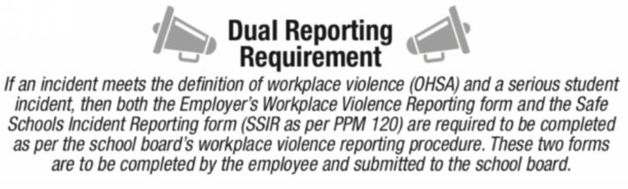
Dual Reporting Requirement
If the alleged assailant in a workplace violence incident is a student;
and the student may also have engaged in a serious student incident;
then both the school board’s workplace violence reporting form and the Safe Schools Incident Reporting Form: Part One must be completed.
Notes:
Presenter Notes:
(Getting started with the road map -- Dual reporting requirement)
The image on the right of this slide, “Dual Reporting Requirement”, is an excerpt from the Road Map.
The OHSA definition of workplace violence is included in the Training Resource (1. Reporting Workplace Violence Incidents (OHSA)) and on the Road Map.
The list of serious student incidents is included in Appendix 2 and Appendix 5 of the Training Resource.

Slide 14
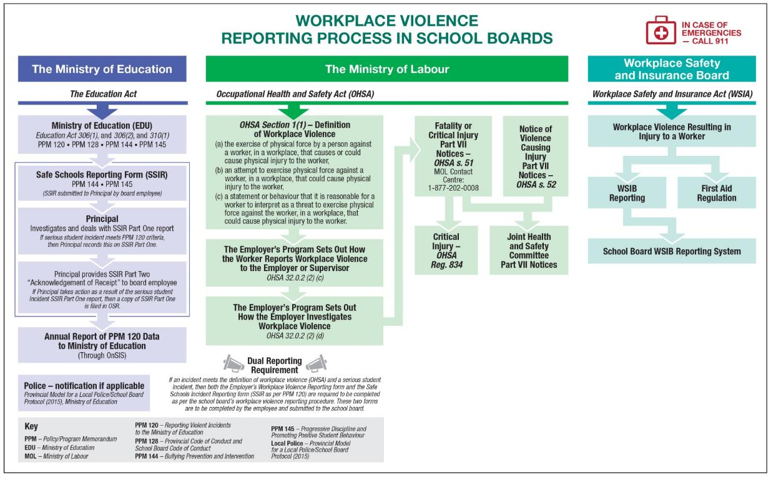
FOLLOWING THE ROAD MAP A look at each of the three sections, starting with the OHSA
Notes:
Presenter Notes:
(Following the road map)
This section of the Training Resource summarizes each of the Road Map’s three main reporting processes (OHSA, Education Act, WSIA) and provides information about each step that may be required. These steps are shown on the Road Map as boxes.
Note that the content of each Road Map “box” becomes a subtitle in the Training Resource.
This section begins by covering the reporting process under the Occupational Health and Safety Act (OHSA) – the green section in the middle of the Road Map; then the Education Act – the blue section to the left; and finally the Workplace Safety and Insurance Act (WSIA) – the aqua section on the right.
Presenter notes include legal references (e.g., Education Act, section 306) for the presenter’s information. It is not necessary to give these references as part of the presentation.

Slide 15
1. Reporting Workplace Violence Incidents (OHSA)
The OHSA sets out a definition of workplace violence.
Workers must report incidents that meet this definition. The employer’s workplace violence program sets out how the employer will investigate and deal with such incidents.
The employer must meet requirements for giving notice of fatality or critical injury, and of worker injury that requires medical attention or disables a worker.
Notes:
Presenter Notes:
(Following the road map -- 1. Reporting Workplace Violence Incidents (OHSA))
The Ministry of Labour administers the Occupational Health and Safety Act (OHSA).
The OHSA definition of workplace violence is located in the first green box shown on this slide. (Read aloud if desired.)
If an incident meets this definition, there are reporting procedures under the employer’s workplace violence program that must be followed (OHSA, s. 32.0.2).
Following is a brief summary of the steps in the reporting process:
The worker must report the incident to the supervisor or employer.
The employer’s workplace violence program sets out how the employer will investigate and deal with the incident (OHSA, s. 32.0.2).
If the incident results in a fatality or critical injury (as defined in Regulation 834), the employer must meet time-sensitive requirements to give notice to the Ministry of Labour, the Joint Health and Safety Committee (JHSC), the health and safety representative, and the union (OHSA, s. 51).
If the incident results in an injury to a worker that requires medical attention or disables the worker so that they are not able to perform their usual work, the employer must meet time-sensitive requirements to give notice to the JHSC, the health and safety representative, and the union (OHSA, s. 52).

Slide 16
2. Reporting Serious Student Incidents (Education Act)
Serious student incidents are activities for which suspension or expulsion must be considered.
School board employees and principals are required to follow the reporting process for serious student incidents.
The reporting process requires the use of the Safe Schools Incident Reporting Forms.
If the principal takes action as a result of the serious student incident, OSR documentation is required.
If the incident meets PPM 120 criteria, the principal reports this on the Safe Schools Incident Reporting Form – Part One.
Notes:
Presenter Notes:
(Following the road map -- 2. Reporting Serious Student Incidents)
The Ministry of Education administers the Education Act.
Under the Education Act, serious student incidents are activities for which suspension or expulsion must be considered by the principal (Education Act, ss. 306 and 310). The Act sets out the duties of board employees and of the principal with regard to the reporting process.
Appendix 2 of the Training Resource includes a list of serious student incidents for reporting purposes.
PPM No.144, “Bullying Prevention and Intervention”, and PPM No. 145, “Progressive Discipline and Promoting Positive Student Behaviour”, include ministry direction about the required reporting process, including the use of the Safe Schools Incident Reporting Forms (reproduced in Appendix 5 of the Training Resource).
PPM No. 120, “Reporting Violent Incidents to the Ministry of Education”, identifies seven types of violent incidents that school boards must report on an annual basis to the Ministry of Education.
Please refer to the Training Resource for further details about these requirements.
Note: On October 17, 2018, sections 306 and 310 of the Education Act have been amended on the subject of cannabis.
The activity of possessing alcohol or illegal drugs has been amended to read “alcohol, illegal drugs or, unless the pupil is a medical cannabis user, cannabis”.
The activity of being under the influence of alcohol has been amended to read “alcohol or, unless the pupil is a medical cannabis user, cannabis”.
The activity of giving alcohol to a minor has been amended to read “alcohol or cannabis”.
These amendments have also been reflected in changes to PPM No. 145 and the Ministry’s Safe Schools Incident Reporting Forms.

Slide 17

Police -- notification if applicable Provincial Model for a Local Police/School Board Protocol (2015)
School boards are required to follow the
Provincial Model for a Local Police/School
Board Protocol, including notifying the police
in certain situations.
The Protocol includes:
Specific types of incidents for which reporting to the police is mandatory.
For example: physical assault causing bodily harm requiring treatment by a medical practitioner.
Specific types of incidents for which reporting to the police is discretionary. For example: threats of serious physical injury.
The principal considers mitigating and other factors when deciding whether to call the police in discretionary situations.
Notes:
Presenter Notes:
(Following the road map -- Provincial Model for a Local Police/School Board Protocol)
PPM No. 145 notes that school boards must follow the direction provided in the Provincial Model for a Local Police/School Board Protocol (2015) (also called the Protocol) with respect to incidents that require police notification and response.
The Training Resource lists the types of incidents that call for mandatory and discretionary notification of police. See Section 2 and Appendix 2.
The Protocol includes further information regarding mitigating factors and other factors of particular interest to the principal, such as occurrences involving students under age 12 and investigations involving students with special education needs.
Note that the Protocol’s directions for police notification do not replace school board procedures for a board employee to call 911 in case of emergencies.
The Protocol outlines the 22 key elements that must be included in local police/school board protocols across the province. It also includes provincial policies for lockdown procedures and bomb threat procedures in elementary and secondary schools. The Protocol was established jointly by the Ministry of Education and the Ministry of Community Safety and Correctional Services.

Slide 18
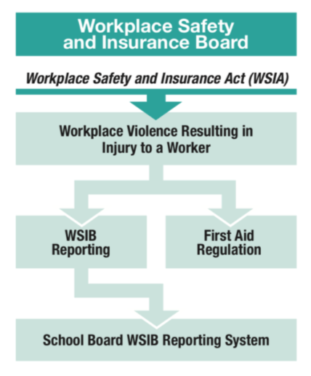
3. Reporting Workplace Injuries (WSIA)
If a workplace violence incident results in an injury to a worker, the injury should be reported to the supervisor or the employer as soon as possible. First aid and/or medical attention should be administered promptly if necessary.
Under some circumstances, the injury must also be reported to the Workplace Safety and Insurance Board (WSIB).
For example, the employer must notify the WSIB about worker injury that resulted in lost time or medical attention.
The employer must keep a record of first-aid treatments provided to workers.
The school board’s WSIB Reporting System is structured to meet reporting requirements.
Notes:
Presenter Notes:
(3. Reporting workplace injuries (WSIA))
The Workplace Safety and Insurance Board (WSIB) administers the Workplace Safety and Insurance Act (WSIA).
A workplace injury resulting from a violent incident should be recorded on the school board’s workplace violence report and reported on the school board’s incident/injury report.
School board procedures for reporting workplace injury and illness help to ensure that injured workers get the help they need; that steps can be taken for future prevention of injury and control of risk; and that requirements for reporting to the WSIB, if applicable, are met.
If a workplace injury involves contact with blood or other potentially infectious body fluids then this information should be included in the worker’s injury report to the principal. This information should also be considered in steps taken for first aid and medical attention.

Slide 19
APPENDICES
This PowerPoint includes Appendices 1 and 2 and a scenario from Appendix 3. Please refer to the Training Resource for the complete set of appendices.
Appendix 1. Reporting requirements for various types of incidents
Appendix 2. Definitions related to reporting violent incidents
Appendix 3. Scenarios about reporting requirements
Appendix 4. R.R.O. 1990, Regulation 834: Critical Injury – Defined
Appendix 5. Safe Schools Incident Reporting Forms
Notes:
Presenter Notes:
(Appendices)
The Appendices include a chart, definitions, scenarios, the definition of critical injury, and the Safe Schools Incident Reporting Forms.
Appendices 1 and 2 provide quick reference guides that can support the use of the Road Map and the Training Resource. These appendices are included in this PowerPoint.
Appendix 3 provides four scenarios that require decision making about reporting requirements, as well as a template for future use. One of the scenarios is included in this PowerPoint.
Appendices 4 and 5 are not included in this PowerPoint; please refer to the Training Resource.

Slide 20
Appendix 1. Reporting requirements for various types of incidents
Notes:
Presenter Notes:
(Appendices -- Appendix 1: Chart of reporting requirements for various types of incidents)
The question “What type of incident is this?” is one of the four key questions about reporting an incident (see the section “Getting Started”).
More than one reporting process may be required.
This chart shows the connections between the type of incident that occurred and the reporting process that is required.

Slide 21
Excerpt from Appendix 2: Definitions related to reporting violent incidents
Workplace violence, Ontario Health and Safety Act (OHSA)*
“Workplace violence” means:
the exercise of physical force by a person against a worker, in a workplace, that causes or could cause physical injury to the worker,
an attempt to exercise physical force against a worker, in a workplace, that could cause physical injury to the worker,
a statement or behaviour that it is reasonable for a worker to interpret as a threat to exercise physical force against the worker, in a workplace, that could cause physical injury to the worker.
* Note: Incidents not listed under “Workplace Violence, OHSA definition” may still qualify as workplace violence incidents under the Occupational Health and Safety Act (OHSA). Refer to the OHSA for additional information.
Notes:
Presenter Notes:
(Appendices -- Appendix 2: Definitions related to reporting violent incidents)
Appendix 2 collects the definitions related to violent incidents (according to the relevant statutes) as a quick reference guide. Included are definitions of:
workplace violence
serious student incidents
violent incidents as laid out in PPM No. 120, and
occurrences for which police response is mandatory and discretionary.
It is important to consult the original documents for additional information. (See “Resources”.)
Note: On October 17, 2018, sections 306 and 310 of the Education Act were amended on the subject of cannabis.
These amendments were reflected in revisions to PPM No. 145 and the Ministry’s Safe Schools Incident Reporting Forms.
Further details about these amendments were provided in the presenter notes for the slide “Reporting Serious Student Incidents”.

Slide 22
Excerpt from Appendix 3. Scenarios about reporting requirements Scenario 1
A Grade 8 student posts on a social networking site that she intends to cause serious physical injury to a teacher. The student has a history of violent behaviour. The teacher is a member of a religious group. The student’s online threat also includes statements and images that express hatred towards the teacher’s religious group; identifies the teacher by name; and includes a link to a website that also expresses hate towards the religious group. Upon learning of the incident, the principal contacts the police and informs the targeted teacher. The school board and local police conduct coordinated investigations.
Notes:
Presenter Notes:
(Appendices -- Appendix 3: Scenarios about reporting requirements)
Appendix 3 provides four scenarios that involve decision making about the reporting requirements for violent incidents. Here is one of the scenarios.
The scenarios are designed to provoke discussion about how the Road Map is used.
Each scenario includes a completed checklist of reporting requirements and a version of the Road Map with the required reporting actions flagged.
Appendix 3 also includes a master template of the checklist, which could be used to create new scenarios or adapted for practical use.
Please refer to Appendix 3 in the Training Resource to review this scenario with its completed checklist and flagged Road Map.

Slide 23
RESOURCES
The Training Resource concludes with a list of resources including all relevant documents published by the Ministry of Education, the Ministry of Labour and the Workplace Safety and Insurance Board, as well as the statutes and regulations.
Notes:
Presenter Notes:
(Resources)
The resource list includes hyperlinks to all documents cited in the Training Resource.

